Slide 1
SC Demo Task 4
Applications & Datasets

Slide 2
HarpDAAL Algorithms
Learning Tasks | Algorithms | Notes
Classification | Naive Bayes, Neural Network | Naive Bayes is not iterative algorithm
Regression | Linear Regression, Ridge Regression | all solved by normal equation, not iterative algorithms
Clustering | K-means
Recommender System | Matrix Factorization(SGD), ALS
Dimension Deduction | SVD, PCA, QR
Statistics | Moments, Covariance

Slide 3
Applications for Demo
Learning Tasks | Algorithms | Dataset | Notes
Clustering | K-means | 15scene | Fifteen Scene Categories
Regression | Linear Regression | lfw | Labeled Faces in the Wild(LFW) people
Classification | Naive Bayes | 20news | 20 newsgroups
 | Neural Network | mnist8m | handwritten digits
Recommender System | Matrix Factorization(SGD) | movielens | Rating data sets from the MovieLens web site

Slide 4
General Machine Learning Pipeline
Data
Extract Features
Train Model
Evluate
Deploy
Training
define the problem, (binary or multiclass, classfication or regression,evaluation metric...)
dataset preparation, (data collection, data munging, cleaning, split,normalization, ...)
feature engineering, (feature selection, dimension reduction, ...)
Training: select model and hyper-parameter tuning
output the best models with optimized hyper-parameters

Slide 5
Clustering: K-means

Slide 6
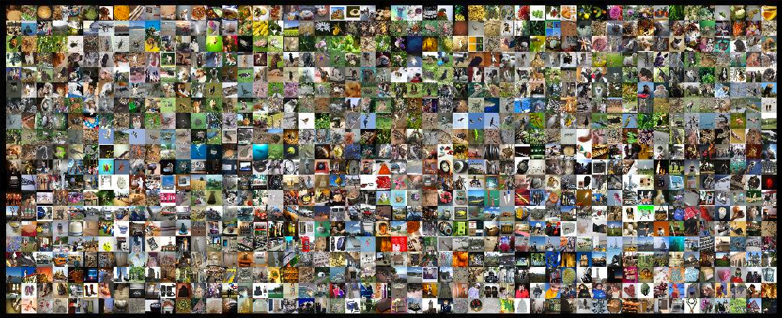
Problem
ImageNet
It's non-trivial to investigate the large scale image collections which contains billions of images.
Image clustering algorithms,such as K-Means,will encounter performance and scalability issues when deploied on large scale data.

Slide 7
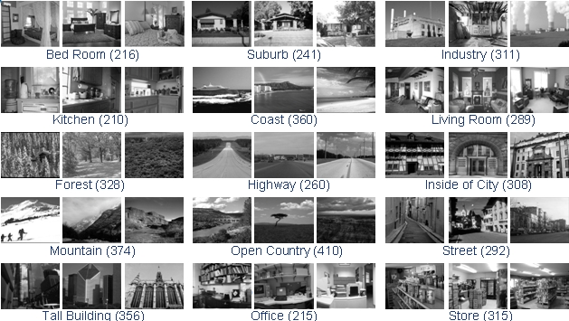
Demo DataSet
This is a dataset of fifteen natural scene categories that expands on the thirteen category dataset released by Fei-Fei Li. The two new categories are industrial and store.
Use the label as ground truth to evaluate the performance of K-Means.
Notes:
http://www.cs.ucf.edu/~liujg/co_clustering.html

Slide 8
Solution
Data
Extract Features
Train Model
Evluate
Data: 15Scene,4485 images,15 categroies
Features: extract 1000 sbow features with the imagenet feature extraction tool ILSVRC2010_devkit-1.0.
Train: K-Means, euclidean distance on sbow features, K=15
Evaluate: cluster quality metrics, such as homo(homogeneity score), ARI(adjusted Rand index) etc.

Slide 9
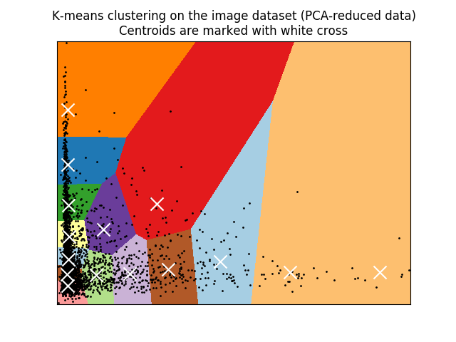
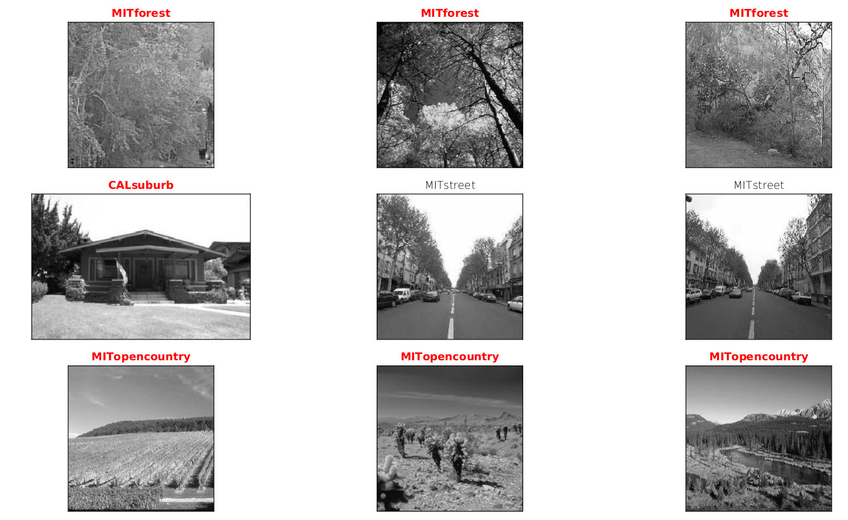
Result
result: sample images of the result clusters, one row for each cluster

Slide 10
Regression: LinearRegression

Slide 11
Problem
It's the most basic type of method that commonly used predictive analysis.
General Linear Regression Models are a set of methods intended for regression in which the target value is expected to be a linear combination of the input variables.

Slide 12
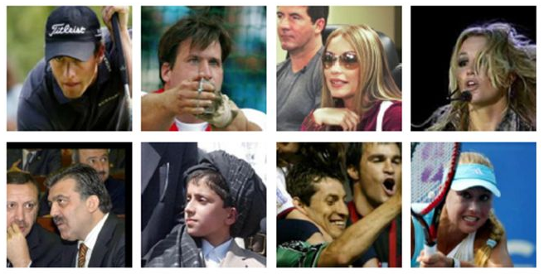
Demo Data
This example shows the use of multi-output estimator to complete images.
The goal is to predict the lower half of a face given its upper half.
Labeled Faces in the Wild(LFW) people

Slide 13
Solution
Data
Extract Features
Train Model
Evluate
Data: lfw, 5985 images(50x37),400 categroies
Features: Each pixel of each channel (color in RGB) is encoded by a float in range 0.0 - 1.0.
Train: LinearRegression,RidgeRegression
Evaluate:

Slide 14
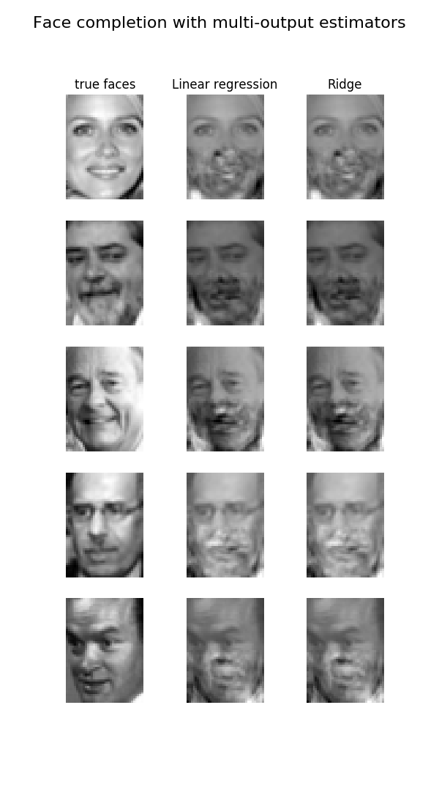
Result
simple demo that demostrates the broadly applicable of linear regression models

Slide 15
Classification: Navie Bayes

Slide 16
Problem
Text categorization (a.k.a. text classification) is the task of assigning predefined categories to free-text documents. It can provide conceptual views of document collections and has important applications in the real world.

Slide 17
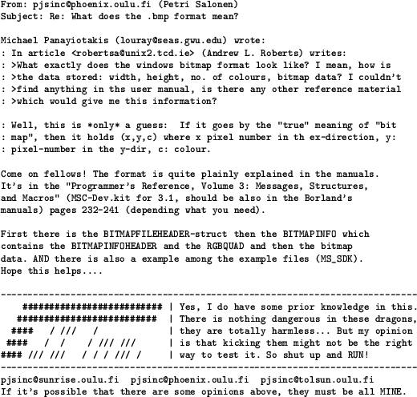
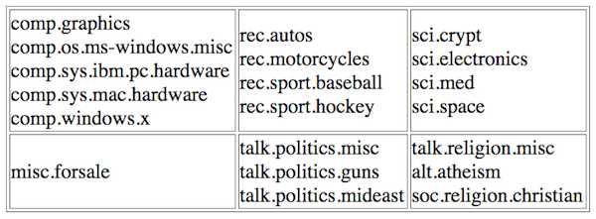
Demo Data
The 20 newsgroups dataset comprises around 18000 newsgroups posts on 20 topics

Slide 18
Solution
Data
Extract Features
Train Model
Evluate
Data: 20news, 18,846 documents,20 categroies,
Features: remove header, quotes; tokenize; vectorize the text content by tf*idf, results in 101,631 uniq features.
Train: Naive Bayes
Evaluate: accuracy, training time

Slide 19
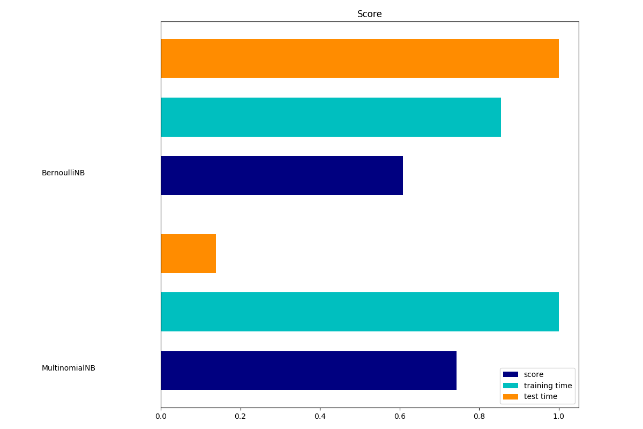
Result
result:
category assigned to documents
query interface:
predict category for new document

Slide 20
Classification: Neural Network

Slide 21
Problem
Large scale image classification is challenging.
Neural network, Multi-layer Perceptron(MLP), which is capable to learn non-linear models got success in this task.
Sometimes looking at the learned coefficients of a neural network can provide insight into the learning behavior.
This example shows how to plot some of the first layer weights in a MLPClassifier trained on the MNIST dataset.

Slide 22
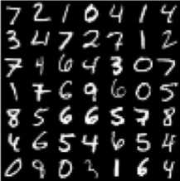
Demo Data
a subset of mnist8m dataset, 100K 28x28 digits images, 10 classes

Slide 23
Solution
Data
Extract Features
Train Model
Evluate
Data: mnist8m, 100k images, 10 categroies
Features: 28x28=784 pixels as a vector
Train: MLP
Evaluate: accuracy,

Slide 24
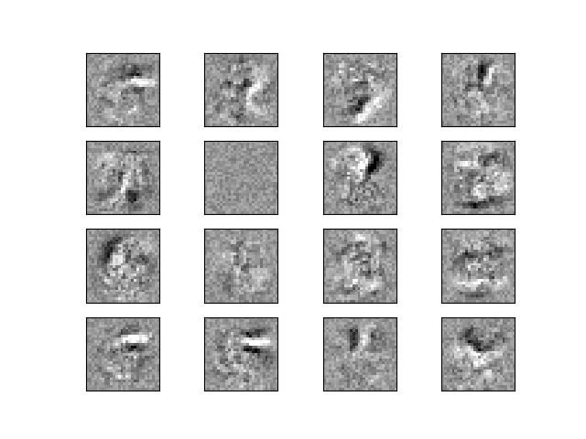
Result
Iteration 27, loss = 0.00044823
Training set score: 1.000000
Test set score: 0.979675
some of the first layer weights

Slide 25
Recommender System: Matrix Factorization(SGD)

Slide 26
Problem
To predict the "rating" or "preference" that a user would give to an item is important for business.
To produce a list of recommendations, Collaborative filtering approaches build a model from a user's past behaviour (items previously purchased or selected and/or numerical ratings given to those items) as well as similar decisions made by other users.

Slide 27
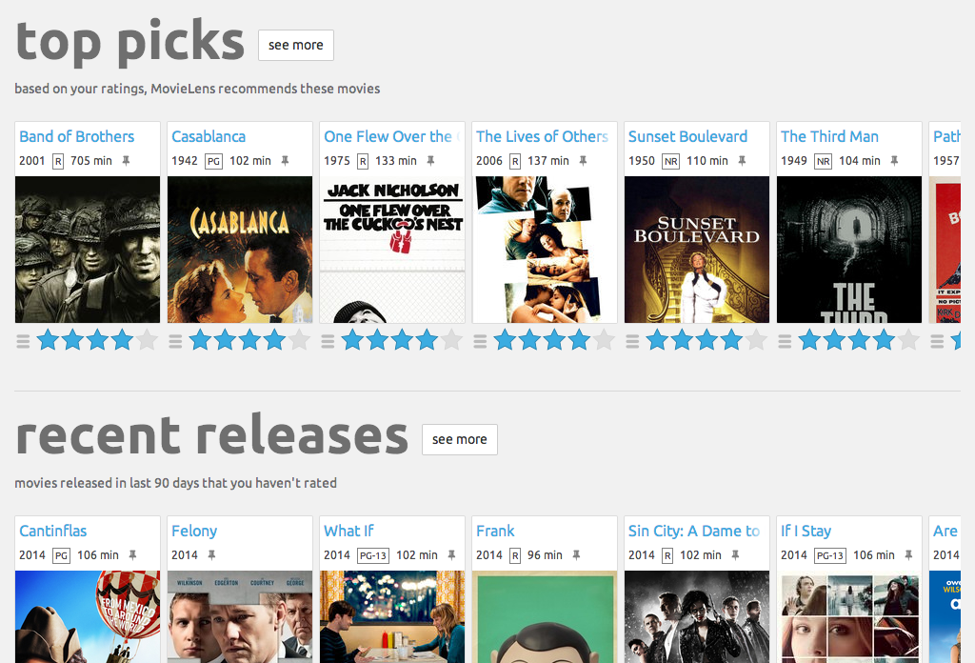
Demo Data
MovieLens 1M dataset
6040 users, 3883 items
1M ratings
https://movielens.org/

Slide 28
Solution
Data
Extract Features
Train Model
Evluate
Data: MovieLens 1M dataset,6040 users, 3883 items,1M ratings
Features: sparse ratings values
Train: mf-sgd
Evaluate: rmse,mae

Slide 29
Result
3-fold cross validation
Mean RMSE: 0.8863
Mean MAE : 0.6964
query interface:
predict rating for unseen items

Slide 30
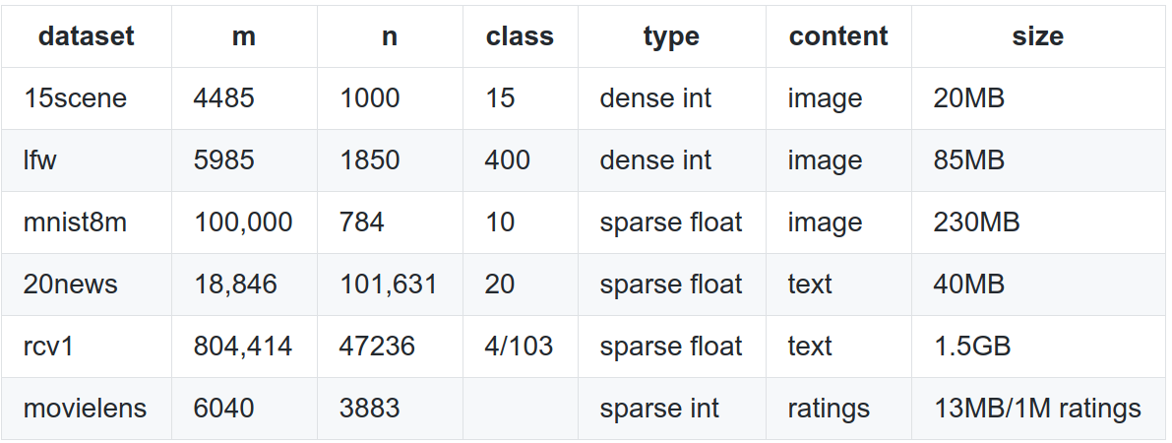
Datasets

Slide 31
Summary
Done
https://github.iu.edu/pengb/scdemo
5 small datasets for 4 typical learning applications ready,
stand-alone python code and running scripts for the demo applications ready
Todo
link the demo code with harpdaal core algorithm by the python interface provided by BoFeng.
Make decision which application should be optimized and focused on, and then improve them.

